Slide 1
Self-supervised learning
Lecturer: Chaim Baskin
1

Slide 2
Motivation
Overcoming reliance on supervised pre-training
Pretext task
Figure source

Slide 3
Self-supervised vs. unsupervised learning
The terms are sometimes used interchangeably in the literature, but self-supervised learning is a particular kind of unsupervised learning
Self-supervised learning: the learner “makes up” labels from the data and then solves a supervised task
Unsupervised learning: any kind of learning without labels
Clustering and quantization
Dimensionality reduction, manifold learning
Density estimation
Learning to sample

Slide 4
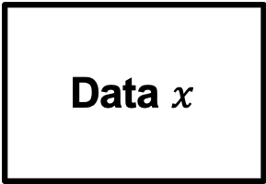
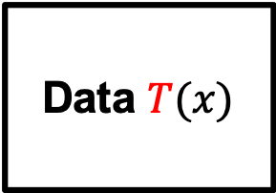
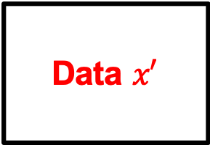
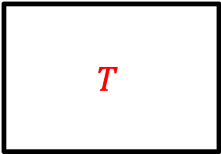
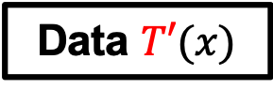
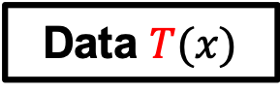
Types of self-supervised learning
Data $x$
Network
Data $x′$
Data prediction
Transformation prediction
Data $T(x)$
Network
$$T$$
Contrastive learning
Data $T(x)$
Network
Similar/
dissimilar
Data $T′(x)$
Source: A. Efros

Slide 5
Self-supervised learning: Outline
Data prediction
Colorization
Transformation prediction
Context prediction, jigsaw puzzle solving, rotation prediction
Deep clustering and instance prediction
Contrastive learning
MoCo, SimCLR, SWaV
Self-supervision beyond still images
Audio, video, language

Slide 6
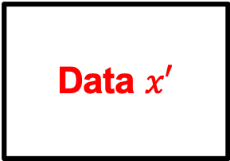
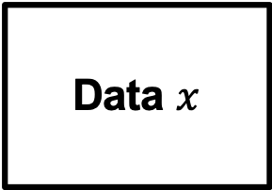
Self-Supervision as data prediction
Data $x$
Network
Data $x′$
Colorization
Inpainting
Cross-channel encoding
Future prediction
Source: A. Efros

Slide 7
Colorization
R. Zhang, P. Isola, and A. Efros, Colorful Image Colorization, ECCV 2016
Notes:
At each spatial location, predict probability distribution over 313 quantized (a,b) values

Slide 8
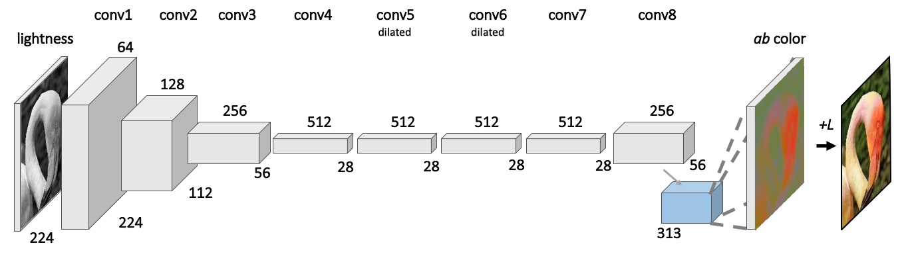
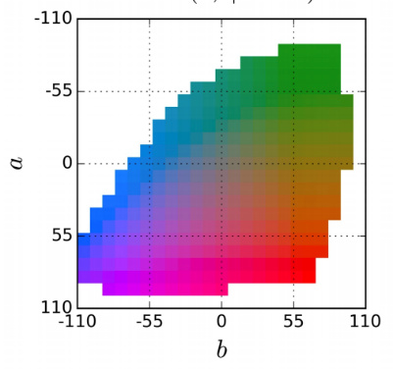
Colorization: Architecture
At each spatial location, predict probability distribution over 313 quantized (a,b) values
R. Zhang, P. Isola, and A. Efros, Colorful Image Colorization, ECCV 2016
Notes:
At each spatial location, predict probability distribution over 313 quantized (a,b) values

Slide 9
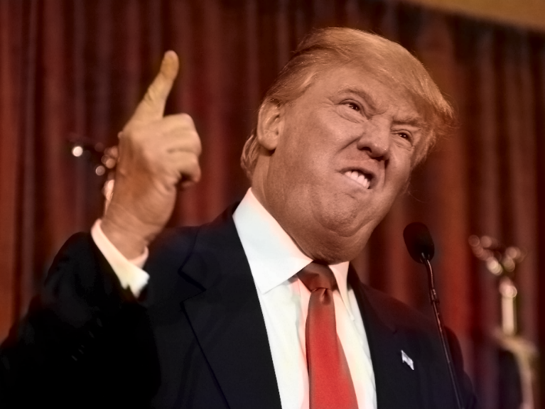
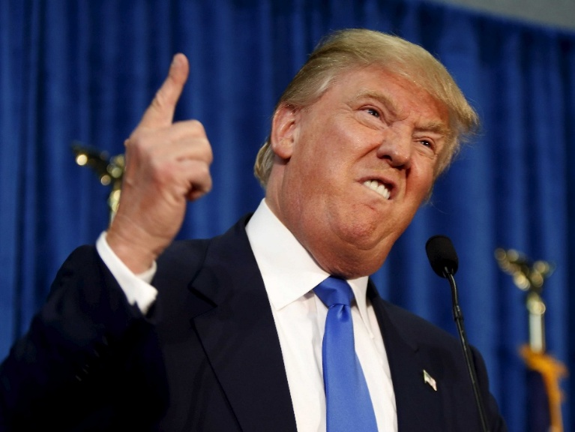
Inherent Ambiguity
Prediction
Ground Truth
Source: A. Efros, R. Zhang
Notes:
This is the output after passing it through our system. Now, it seems to look plausible. Now here is the ground truth. So notice that these two look very different. But even though red and blue are far apart in ab space, we are just as happy with the red colorization as we are with the blue, and perhaps the red is even better...

Slide 10
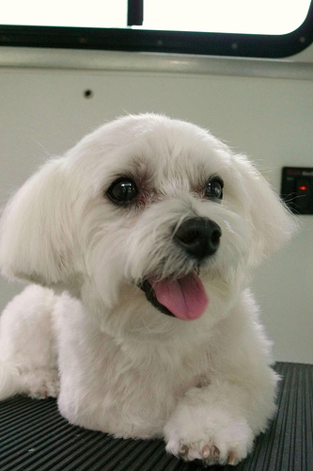
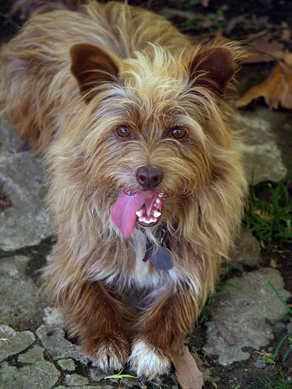
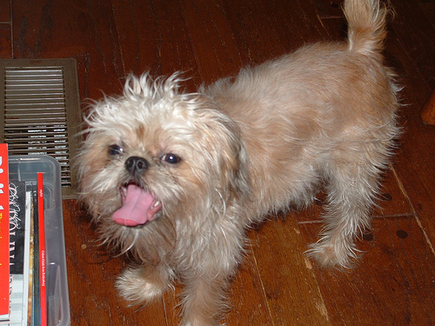
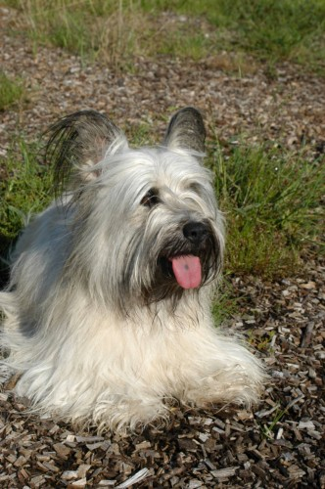
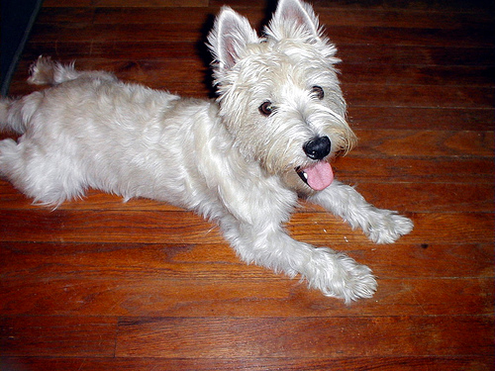
Biases
Source: A. Efros, R. Zhang
Notes:
Also, we find other curious behaviors and biases. For example, when the system sees a dog, it sometimes expects a tongue underneath. Even when there is none, it will just go ahead and hallucinate one for us anyways.

Slide 11
Self-supervised learning: Outline
Data prediction
Colorization
Transformation prediction

Slide 12
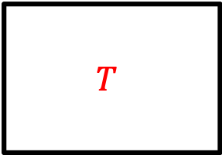
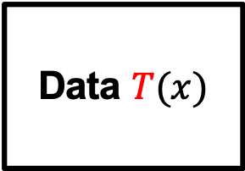
Self-supervision by transformation prediction
Data $T(x)$
Network
$$T$$
Context prediction
Jigsaw puzzle solving
Rotation prediction
Source: A. Efros

Slide 13
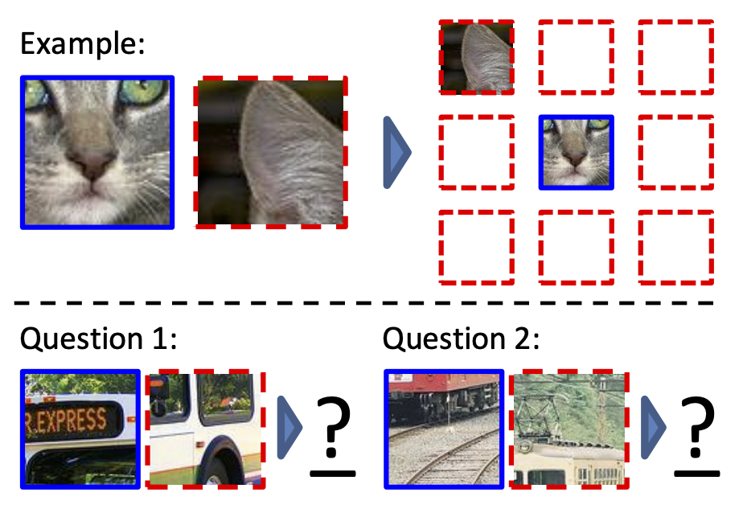
Context prediction
Pretext task: randomly sample a patch and one of 8 neighbors
Guess the spatial relationship between the patches
A: Bottom right
A: Top center
C. Doersch, A. Gupta, A. Efros. Unsupervised Visual Representation Learning by Context Prediction. ICCV 2015

Slide 14
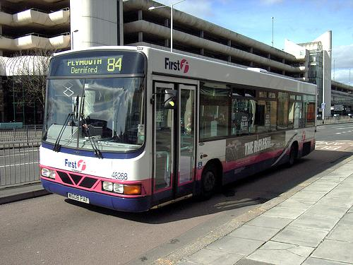
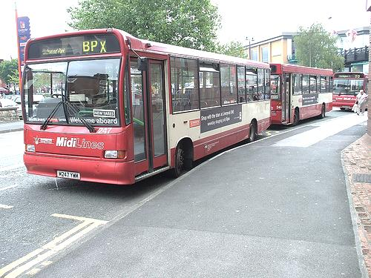
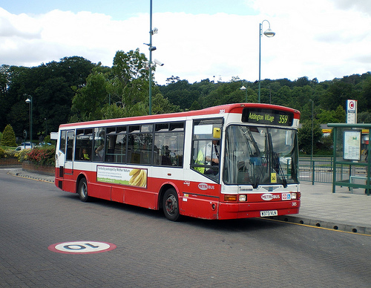
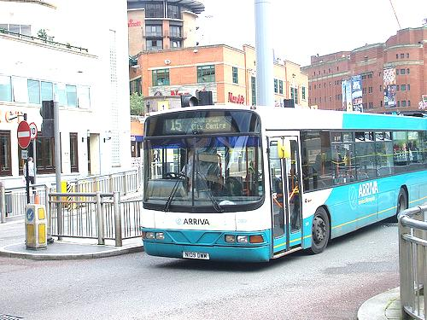
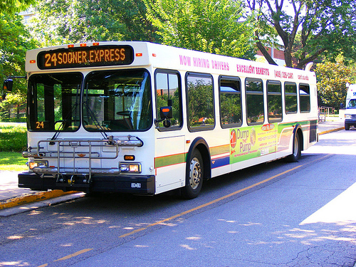
Context prediction: Semantics from a non-semantic task
Source: A. Efros
Notes:
- This is hard if you don’t know what a bus is, but easy if you do.
- We hope that if we give this task to a machine learner, it will also solve it by recognizing semantics.

Slide 15
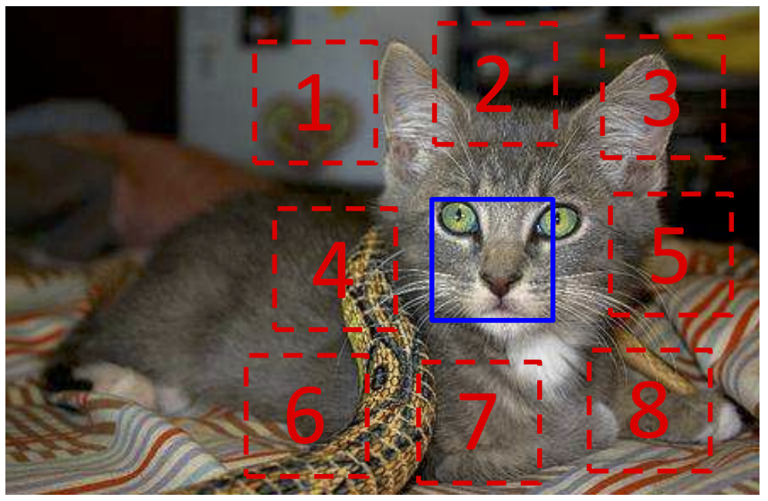
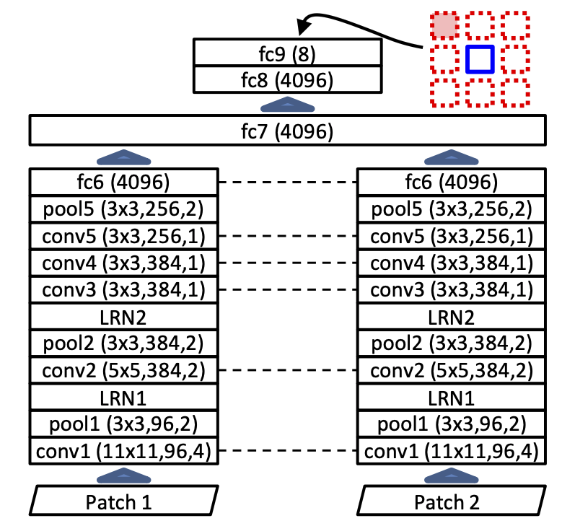
Context prediction: Details
AlexNet-like architecture
softmax
Prevent “cheating”: sample patches with gaps, pre-process to overcome chromatic aberration
shared weights
C. Doersch, A. Gupta, A. Efros. Unsupervised Visual Representation Learning by Context Prediction. ICCV 2015

Slide 16
Context prediction: Results
Use learned weights in R-CNN model to perform detection on PASCAL VOC 2007
Unsupervised pre-training is 5% mAP better than training from scratch, but still 8% below pre-training with ImageNet label supervision
C. Doersch, A. Gupta, A. Efros. Unsupervised Visual Representation Learning by Context Prediction. ICCV 2015

Slide 17
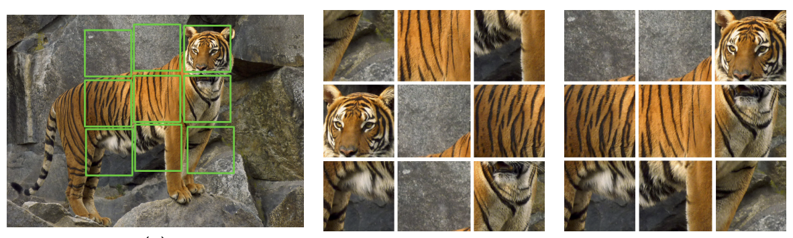
Jigsaw puzzle solving
Crop out tiles
Shuffle
Pretext task: reassemble
Claim: jigsaw solving is easier than context prediction, trains faster, transfers better
M. Noroozi and P. Favaro. Unsupervised Learning of Visual Representations by Solving Jigsaw Puzzles. ECCV 2016

Slide 18
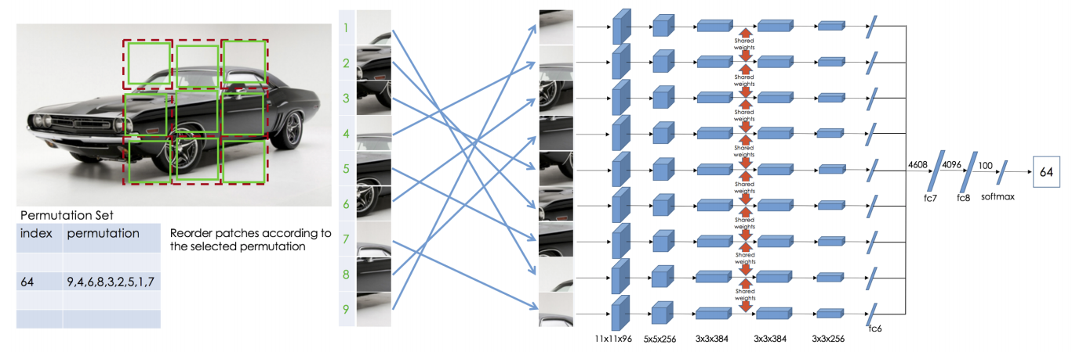
Jigsaw puzzle solving: Details
Context free network (CFN)
Predetermined set of 1000 permutations
(out of 362,880 possible)
M. Noroozi and P. Favaro. Unsupervised Learning of Visual Representations by Solving Jigsaw Puzzles. ECCV 2016

Slide 19
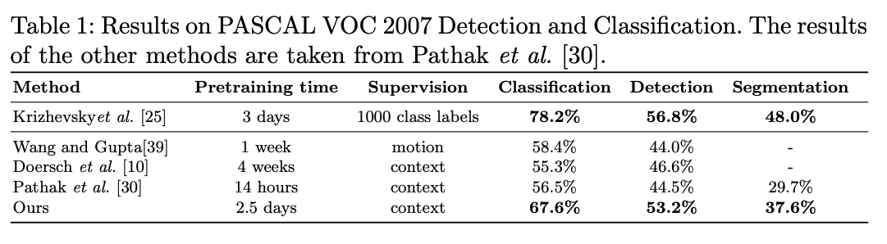
Jigsaw puzzle solving: Transfer results
M. Noroozi and P. Favaro. Unsupervised Learning of Visual Representations by Solving Jigsaw Puzzles. ECCV 2016

Slide 20
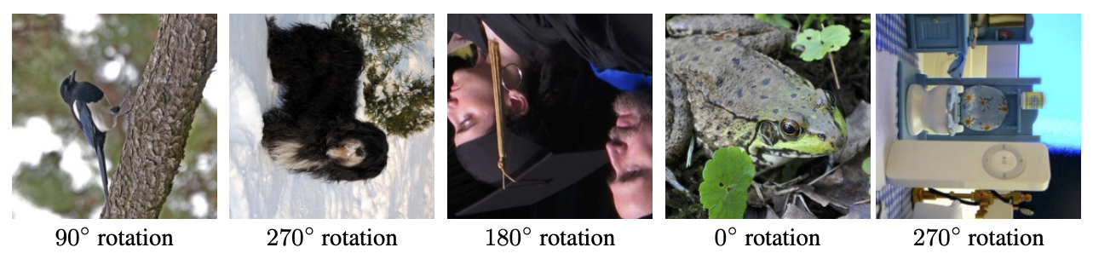
Rotation prediction
Pretext task: recognize image rotation (0, 90, 180, 270 degrees)
S. Gidaris, P. Singh, and N. Komodakis. Unsupervised representation learning by predicting image rotations. ICLR 2018

Slide 21
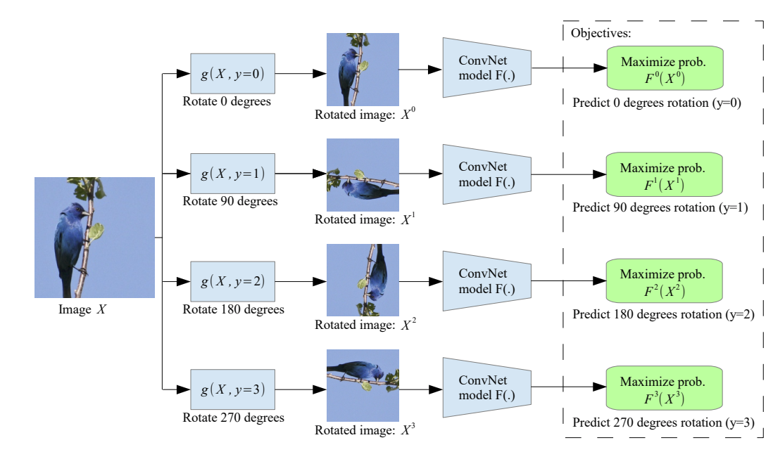
Rotation prediction
During training, feed in all four rotated versions of an image in the same mini-batch
S. Gidaris, P. Singh, and N. Komodakis. Unsupervised representation learning by predicting image rotations. ICLR 2018

Slide 22
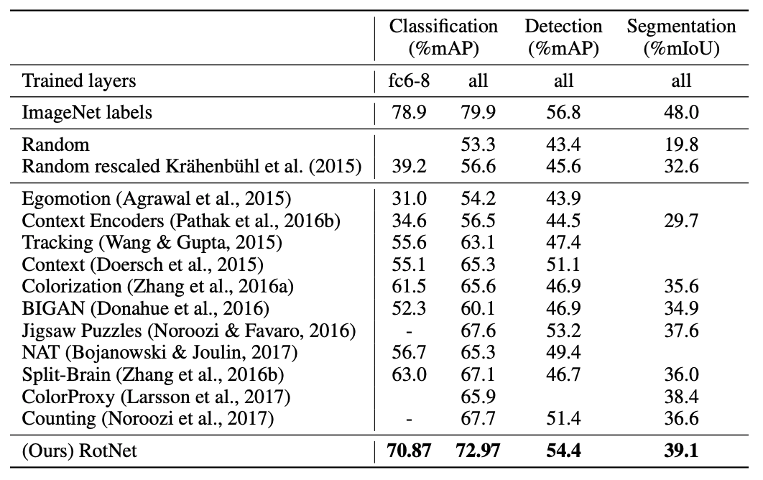
Rotation prediction: Transfer results
S. Gidaris, P. Singh, and N. Komodakis. Unsupervised representation learning by predicting image rotations. ICLR 2018

Slide 23
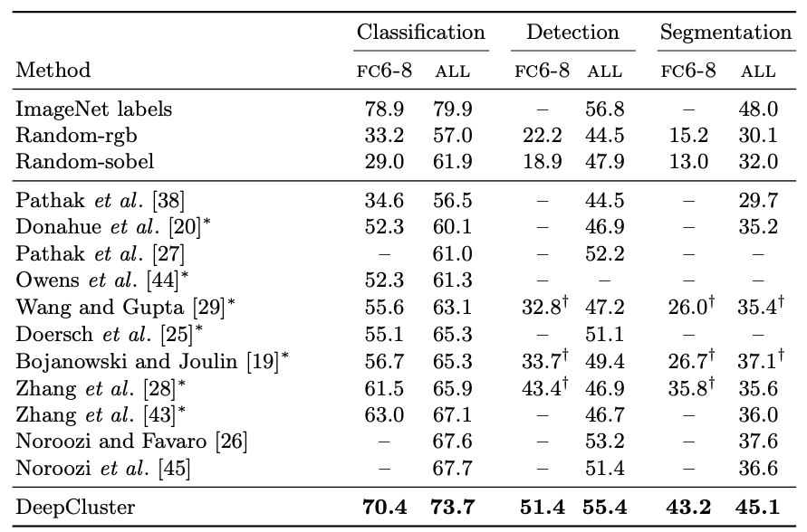
Rotation prediction: PASCAL VOC Transfer results
Method | Classification | Detection (mAP) | Segmentation (mIoU)
Supervised (ImageNet) | 79.9 | 56.8 | 48.0
Colorization | 65.6 | 46.9 | 35.6
Context | 65.3 | 51.1
Jigsaw | 67.6 | 53.2 | 37.6
Rotation | 73.0 | 54.4 | 39.1

Slide 24
Self-supervised learning: Outline
Data prediction
Colorization
Transformation prediction
Context prediction, jigsaw puzzle solving, rotation prediction
Deep clustering

Slide 25
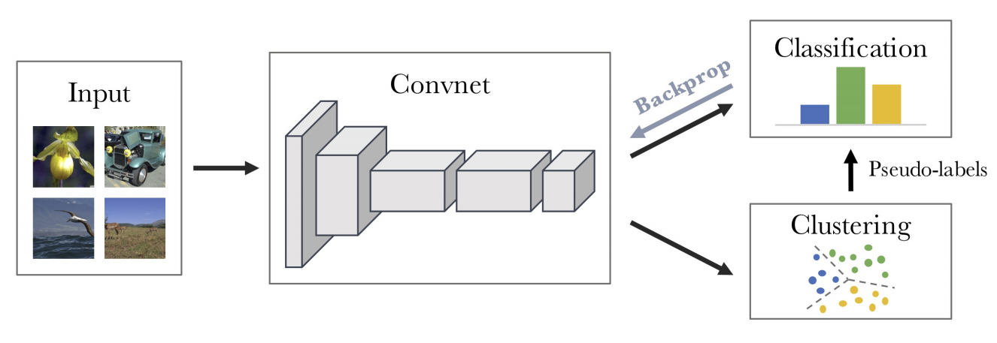
Deep Clustering
Cluster the features to obtain pseudo-labels
Use pseudo-label prediction as pretext task to train the network
Re-cluster the features, iterate
M. Caron, P. Bojanowski, A. Joulin, and M. Douze. Deep clustering for unsupervised learning of visual features. ECCV 2018

Slide 26
Deep Clustering: PASCAL VOC Transfer results
Method | Classification | Detection (mAP) | Segmentation (mIoU)
Supervised (ImageNet) | 79.9 | 56.8 | 48.0
Colorization | 65.6 | 46.9 | 35.6
Context | 65.3 | 51.1
Jigsaw | 67.6 | 53.2 | 37.6
Rotation | 73.0 | 54.4 | 39.1
DeepCluster | 73.7 | 55.4 | 45.1
M. Caron, P. Bojanowski, A. Joulin, and M. Douze. Deep clustering for unsupervised learning of visual features. ECCV 2018

Slide 27
Self-supervised learning: Outline
Data prediction
Colorization
Transformation prediction
Context prediction, jigsaw puzzle solving, rotation prediction
Deep clustering and instance prediction
Contrastive learning
MoCo, SimCLR, SWaV, SEER

Slide 28
Contrastive methods
Encourage representations of transformed versions of the same image to be the same and different images to be different
Data $T(x)$
Network
Similar/
dissimilar
Data $T′(x)$
Source: A. Efros

Slide 29
Contrastive methods
Encourage representations of transformed versions of the same image to be the same and different images to be different
Figure source

Slide 30
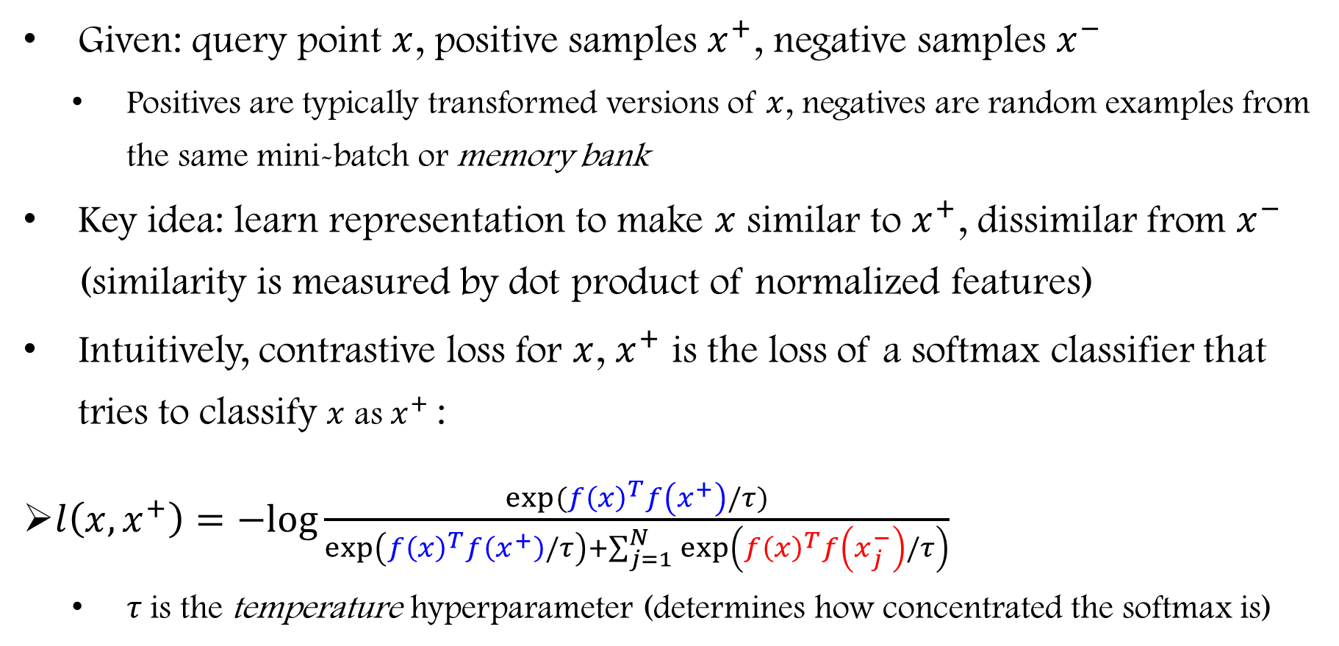
Contrastive loss formulation
Given: query point $x$, positive samples $x^{+}$, negative samples $x^{−}$
Positives are typically transformed versions of $x$, negatives are random examples from the same mini-batch or memory bank
Key idea: learn representation to make $x$ similar to $x^{+}$, dissimilar from $x^{−}$ (similarity is measured by dot product of normalized features)
Intuitively, contrastive loss for $x$, $x^{+}$ is the loss of a softmax classifier that tries to classify $x$ as $x^{+}$:
$l\left(x,x^{+}\right)=−log\frac{exp⁡({f\left(x\right)}^{T}f\left(x^{+}\right)/τ)}{\exp\left({f\left(x\right)}^{T}f\left(x^{+}\right)/τ\right)+\sum_{j=1}^{N}{\exp\left({f\left(x\right)}^{T}f\left(x_{j}^{−}\right)/τ\right)}}$
$τ$is the temperature hyperparameter (determines how concentrated the softmax is)
Notes:
Intuitively, the loss is that of a softmax classifier that tries to classify x as x+

Slide 31
Softmax with temperature
Low temperature:
More concentrated distribution
Higher temperature:
More uniform distribution
Figure source

Slide 32
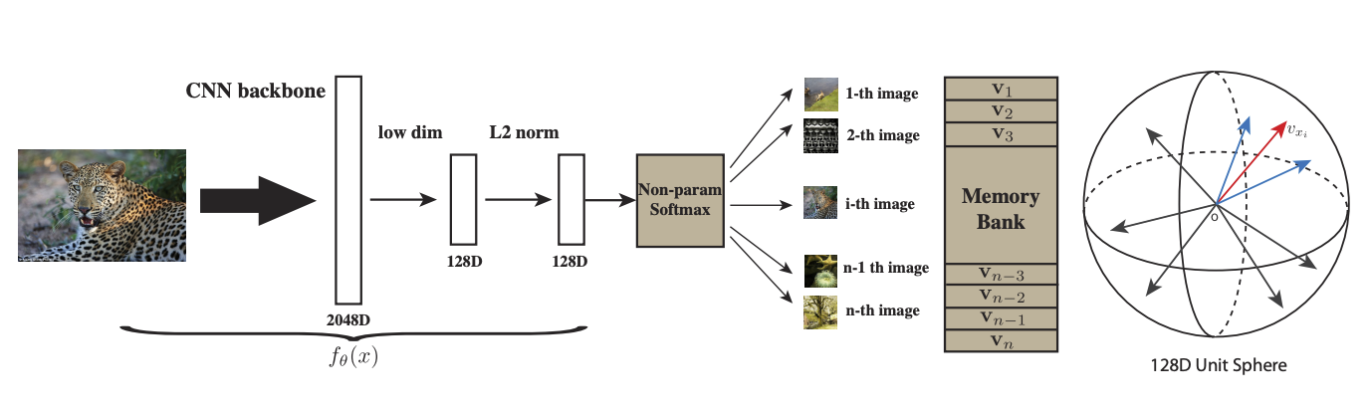
Instance discrimination
Key idea: make each instance into its own class
Z. Wu, Y. Xiong, S. Yu, and D. Lin. Unsupervised Feature Learning via Non-Parametric Instance Discrimination. CVPR 2018

Slide 33
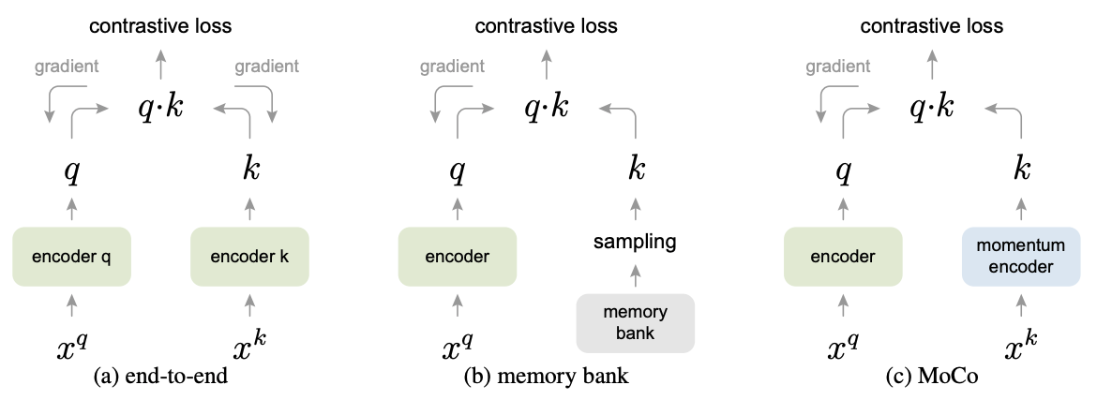
Momentum contrast
Use instance discrimination as pretext task, transform query and key by random augmentations, use queue encoded by a momentum encoder instead of memory bank
K. He et al. Momentum Contrast for Unsupervised Visual Representation Learning. CVPR 2020

Slide 34
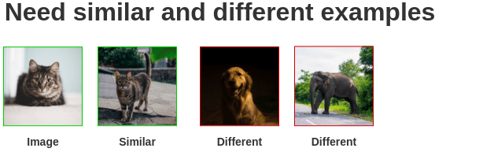
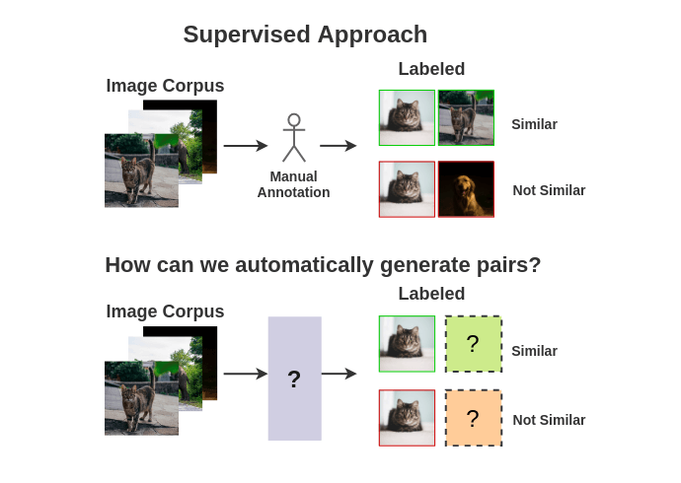
SimCLR
T. Chen, S. Kornblith, M. Norouzi, and G. Hinton. A Simple Framework for Contrastive Learning of Visual Representations. arXiv 2020

Slide 35
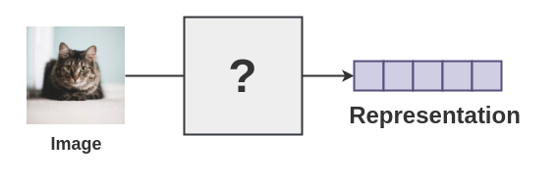
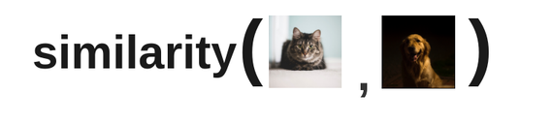
SimCLR
Ability to know what an image represents
Ability to quantify if two images are similar

Slide 36
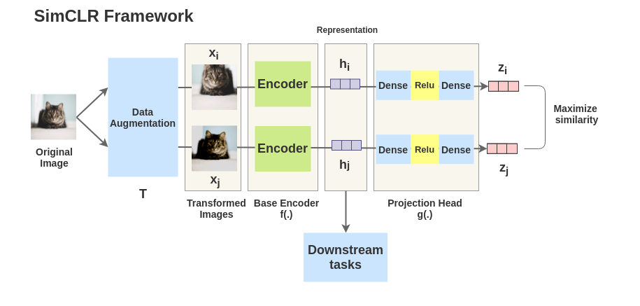
SimCLR
Notes:
The idea of SimCLR framework is very simple. An image is taken and random transformations are applied to it to get a pair of two augmented images xixi and xjxj. Each image in that pair is passed through an encoder to get representations. Then a non-linear fully connected layer is applied to get representations z. The task is to maximize the similarity between these two representations zizi and zjzj for the same image.

Slide 37
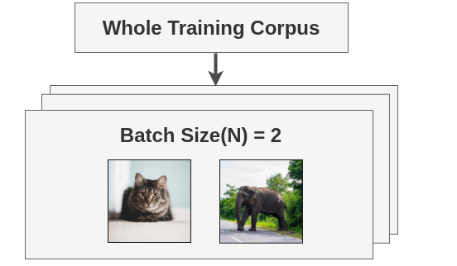
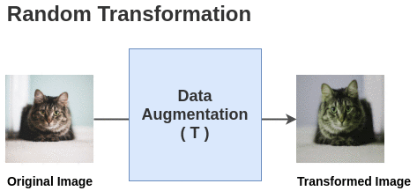
SimCLR
Self-supervised Formulation [Data Augmentation]:

Slide 38
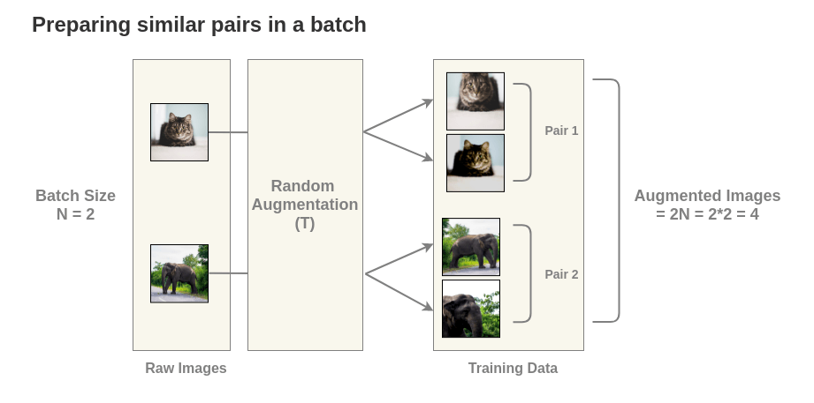
SimCLR
Notes:
For each image in this batch, a random transformation function is applied to get a pair of 2 images. Thus, for a batch size of 2, we get 2*N = 2*2 = 4 total images

Slide 39
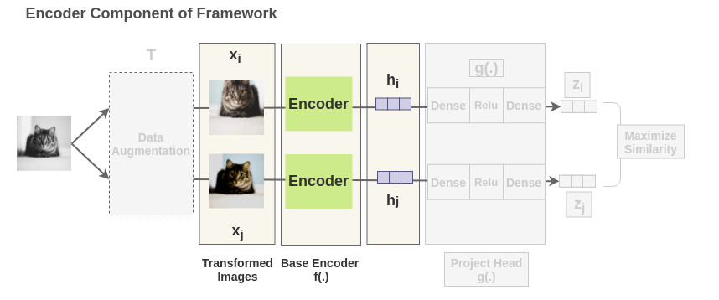
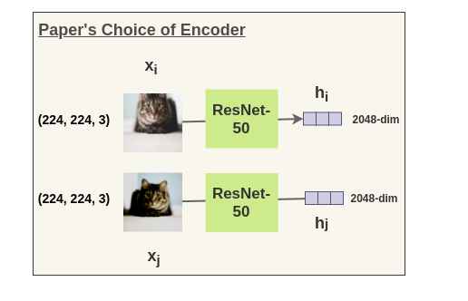
Notes:
Each augmented image in a pair is passed through an encoder to get image representations. The encoder used is generic and replaceable with other architectures. The two encoders shown below have shared weights and we get vectors hihi and hjhj.

Slide 40
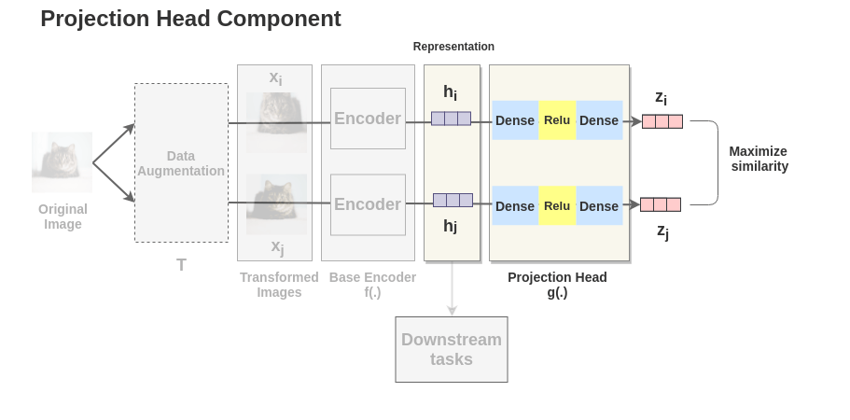
SimCLR
Notes:
The representations hihi and hjhj of the two augmented images are then passed through a series of non-linear Dense -> Relu -> Dense layers to apply non-linear transformation and project it into a representation zizi and zjzj. This is denoted by g(.)g(.) in the paper and called projection head.

Slide 41
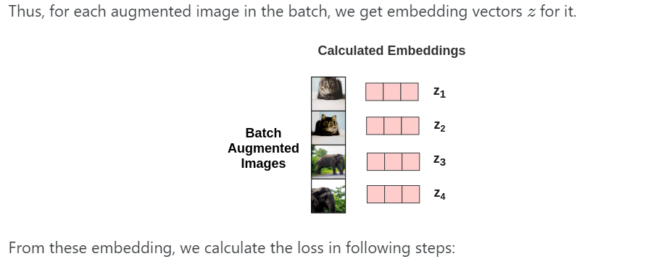
SimCLR

Slide 42

SimCLR
Calculation of Cosine Similarity:

Slide 43

SimCLR
Notes:
The pairwise cosine similarity between each augmented image in a batch is calculated using the above formula. As shown in the figure, in an ideal case, the similarities between augmented images of cats will be high while the similarity between cat and elephant images will be lower.

Slide 44


Slide 45


Slide 46


Slide 47

SimCLR
Notes:
Once the SimCLR model is trained on the contrastive learning task, it can be used for transfer learning. For this, the representations from the encoder are used instead of representations obtained from the projection head. These representations can be used for downstream tasks like ImageNet Classification.

Slide 48

SimCLR: Evaluation
No detection evaluation
T. Chen, S. Kornblith, M. Norouzi, and G. Hinton. A Simple Framework for Contrastive Learning of Visual Representations. arXiv 2020

Slide 49

Swapping Assignments Between Views (SWaV)
Predict cluster assignment of one “view” (transformed version of input image) from representation of another “view”
Prototypes or cluster centers are learned online within mini-batch
Once again, data augmentation strategy matters
M. Caron et al. Unsupervised Learning of Visual Features by Contrasting Cluster Assignments. arXiv 2020

Slide 50


SWaV: Results
Supervised
SWaV
M. Caron et al. Unsupervised Learning of Visual Features by Contrasting Cluster Assignments. arXiv 2020

Slide 51

Self-supervised Pretraining of visual in the wild

Slide 52

Comparison of ImageNet classification

Slide 53

Low-shot learning with SEER

Slide 54
Why do contrastive methods work?
L2 normalization of features (before computing dot product to estimate similarity) is important (Wang and Isola, 2020)
The essential property of the loss is enforcing closeness of positive features while maximizing uniformity of the distribution of features over the hypersphere (Wang and Isola, 2020)
The choice of data augmentation operations or transformations between two positive “views” is also important and needs further study (Tian et al., 2020)

Slide 55
Self-supervised learning: Outline
Data prediction
Colorization
Transformation prediction
Context prediction, jigsaw puzzle solving, rotation prediction
Deep clustering and instance prediction
Contrastive learning
MoCo, SimCLR, SWaV, SEER
Self-supervision beyond still images
Video, audio, language

Slide 56

Learning from audio
A. Owens et al. Ambient Sound Provides Supervision for Visual Learning. ECCV 2016

Slide 57

Future prediction
J. Walker et al. An Uncertain Future: Forecasting from Static Images Using Variational Autoencoders. ECCV 2016

Slide 58

Future prediction
C. Finn and S. Levine. Deep Visual Foresight for Planning Robot Motion. ICRA 2017

Slide 59
Self-supervised learning in NLP
word2vec, GloVe, BERT, ELMO, GPT, …
Figure source

